Slide 1
Hospital Discharge Prediction
Data Science Project 1, Fall-Semester 2023
Samuel Gast
Luka Božović
Teresa Windlin
Notes:
LB
"Welcome to our data science project presentation .Teresa Samuel and I have focused on Hospital Length of Stay prediction. Samuel will be joining us online"

Slide 2
Hospitals face Challenges with allocating Resources
Global Challenge
Workforce Synchronization
Hospitals worldwide are struggling with optimal resource allocation amidst rising costs.
Positioning the right healthcare workers at the right time and place for improved hospital operations, staff well-being, and patient outcomes.
Doctors alone can spend over 30min on Discharge Administration ₍₁₎
(1) Enter source
Notes:
LB
"Faced with a worldwide shortage of medical resources, our project focuses on improving hospital Length of Stay predictions to optimize resource use."

Slide 3
ML-Predictor for Length of Stay (LOS) of Patients in Hospitals
ML Integration in Healthcare Systems
Advanced machine-learning model integration.
Supports clinical decision-making and workflow optimisation.
Accurate LOS Prediction Using Patient Data
Analyses patient-specific clinical and demographic data.
Generates precise hospital length of stay predictions.
Real-Time Prediction Updates
Adapts to new patient information (e.g. diagnostics, clinical assessments).
Maintains updated and relevant LOS forecasts.
Hospital-Specific Customization
Tailors the model to each hospital's unique data and operational needs.
Ensures relevance and efficacy in diverse healthcare settings.
Notes:
LB
"We've developed a machine learning-based approach to predict hospital Length of Stay with increasing accuracy, updating predictions dynamically with each new diagnosis and lab result received by the patient. This method aims to continuously refine resource management and patient care in healthcare facilities through bespoke models tailored for each hospital."

Slide 4
Comparison of ML Models for ICU Stay Prediction
Evt rearange
94.1% Accuracy
Random Forest ₍₁₎
Dina A. Alabbad et al.
This paper focuses on the prediction of the length of stay in the ICU, of COVID-19 affected hospital patients.
93.3% Accuracy
Neural Network ₍₂₎
Changiz Gholipour et al.
This paper focuses on the prediction of the length of stay in wards as well as in ICUs of trauma patients.
This paper focuses on the prediction of the length of stay of patients needing an ICU allocation.
75% Accuracy
Decision Tree ₍₃₎
Mariana Faria et al.
Decision Tree
Random Forest
Neural Network
(1) https://www.ncbi.nlm.nih.gov/pmc/articles/PMC9010025/
(2) https://l1nq.com/PCojP
(3) https://www.sciencedirect.com/science/article/pii/S1877050922016027
Notes:
SG
Existing studies focus on ICU stay while our goal is to predict patients overall LOS,
Approaches: Random forest, NN & Decision Tree (see accuracies on screen). We will also try these 3 approaches.

Slide 5
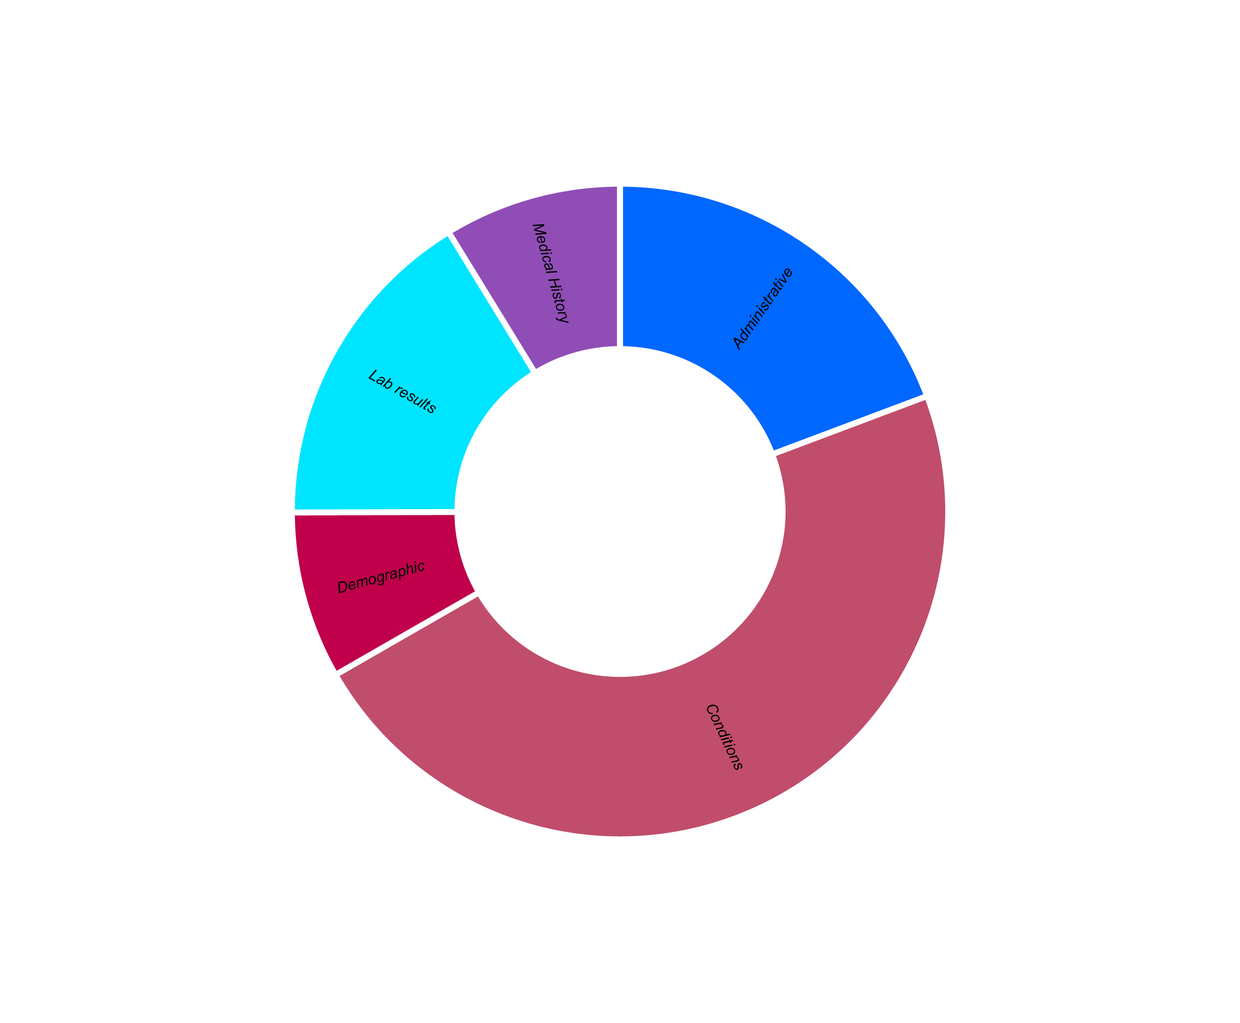
Diverse Dataset with many different Datapoints
Hero DMC Heart Institute Unit, Punjab, India
Data collection period of 2 years
Source: Kaggle ₍₁₎
15’757 Entries,
56 Parameters
(1) https://www.kaggle.com/datasets/ashishsahani/hospital-admissions-data
Notes:
TW
Introducing our dataset which includes records of over 15k patient visits and covers 56 different parameters.
These range from personal details to lab results and health conditions. ,
The data was collected from a cardiovascular hospital in India over a two-year period.

Slide 6
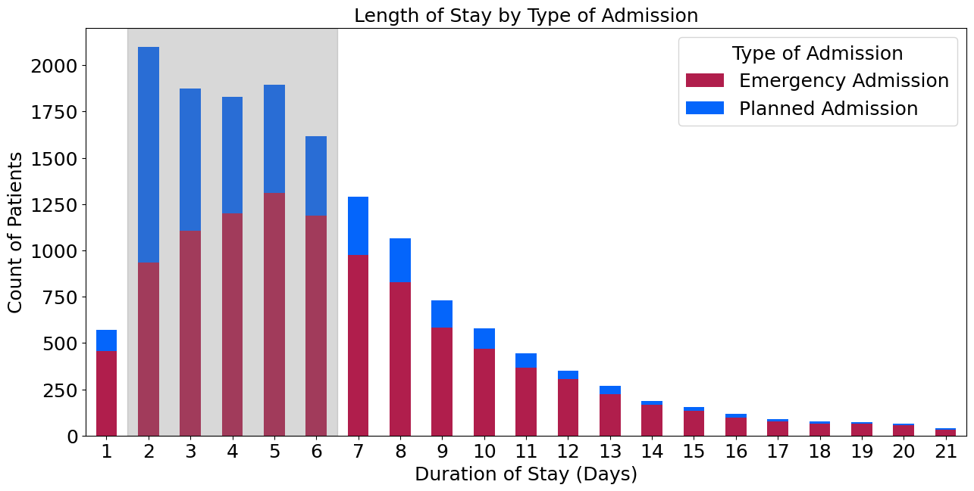





Data Insights: Average LOS and typical Patients
Most Patients
stay 2 to 6 days
Most frequent age:
60–70years
Notes:
TW
Chart shows that most patients stay in the hospital for about 2 to 6 days.
We see that emergency visits account for most longer hospital stays.
Maybe:
Patient demographics are 2/3 male, aged 60-70 and mostly from urban area

Slide 7
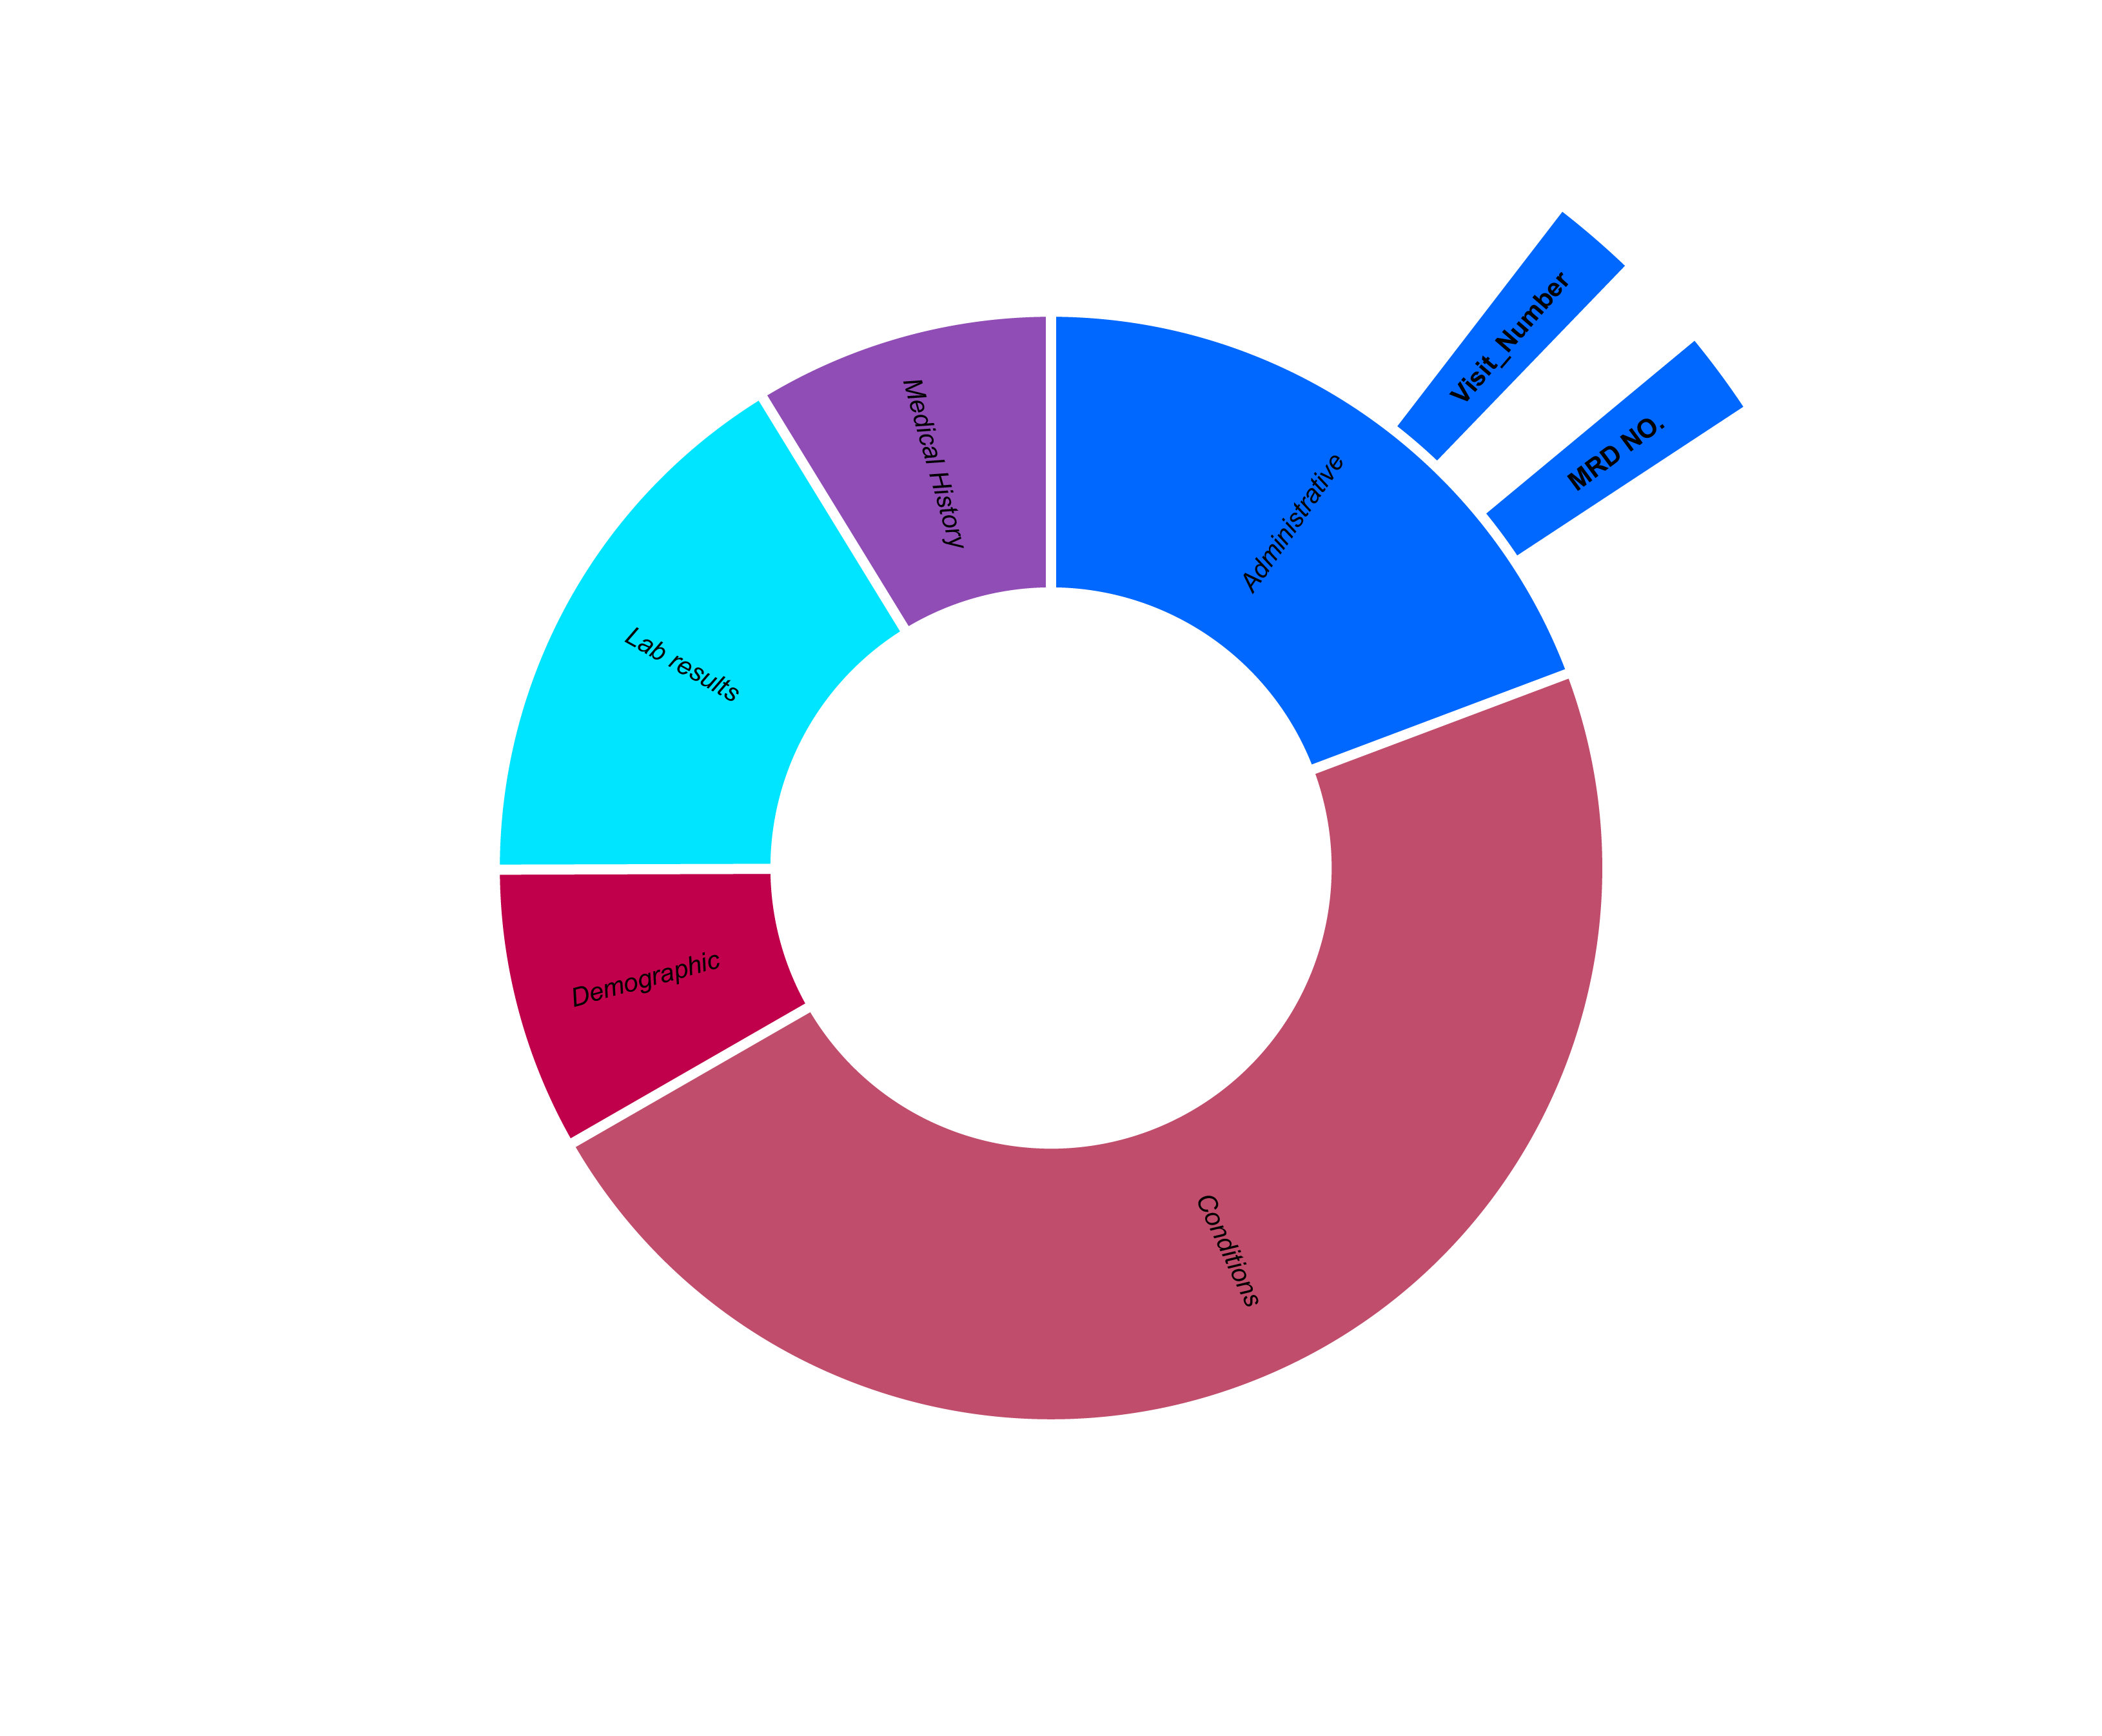
Data engineering: Adding helpful Parameters and removing Entries
Number of past visits by patient
Consider repeated visits in model without overfitting to specific patients based on their “MRD No.”
Notes:
LB
Lets dive into the data
"We're removing the patient unique ID (MRD No) to avoid model overfitting on individual patients, while incorporating 'visit_number' to account for repeat visits and maintain data integrity."

Slide 8
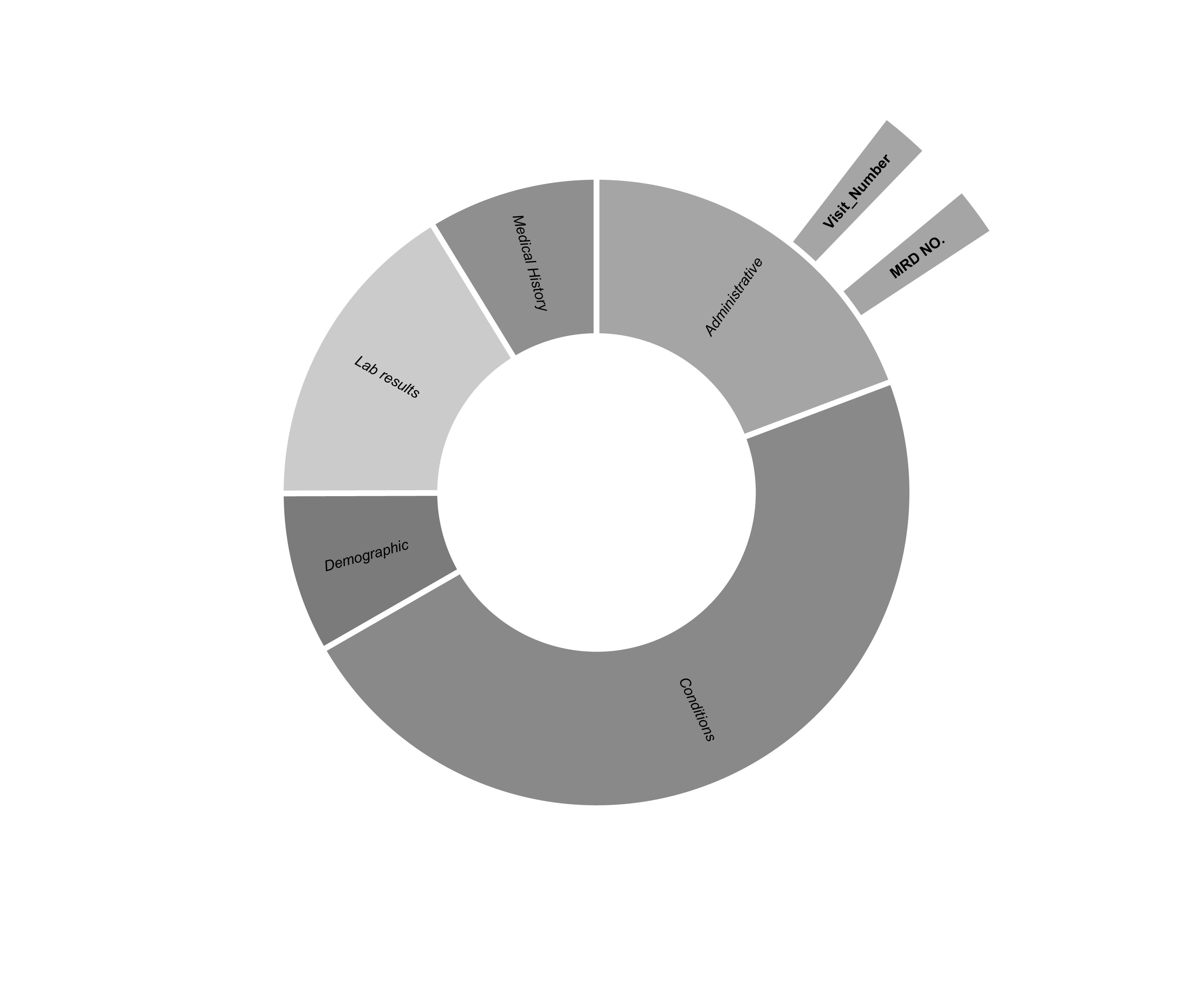
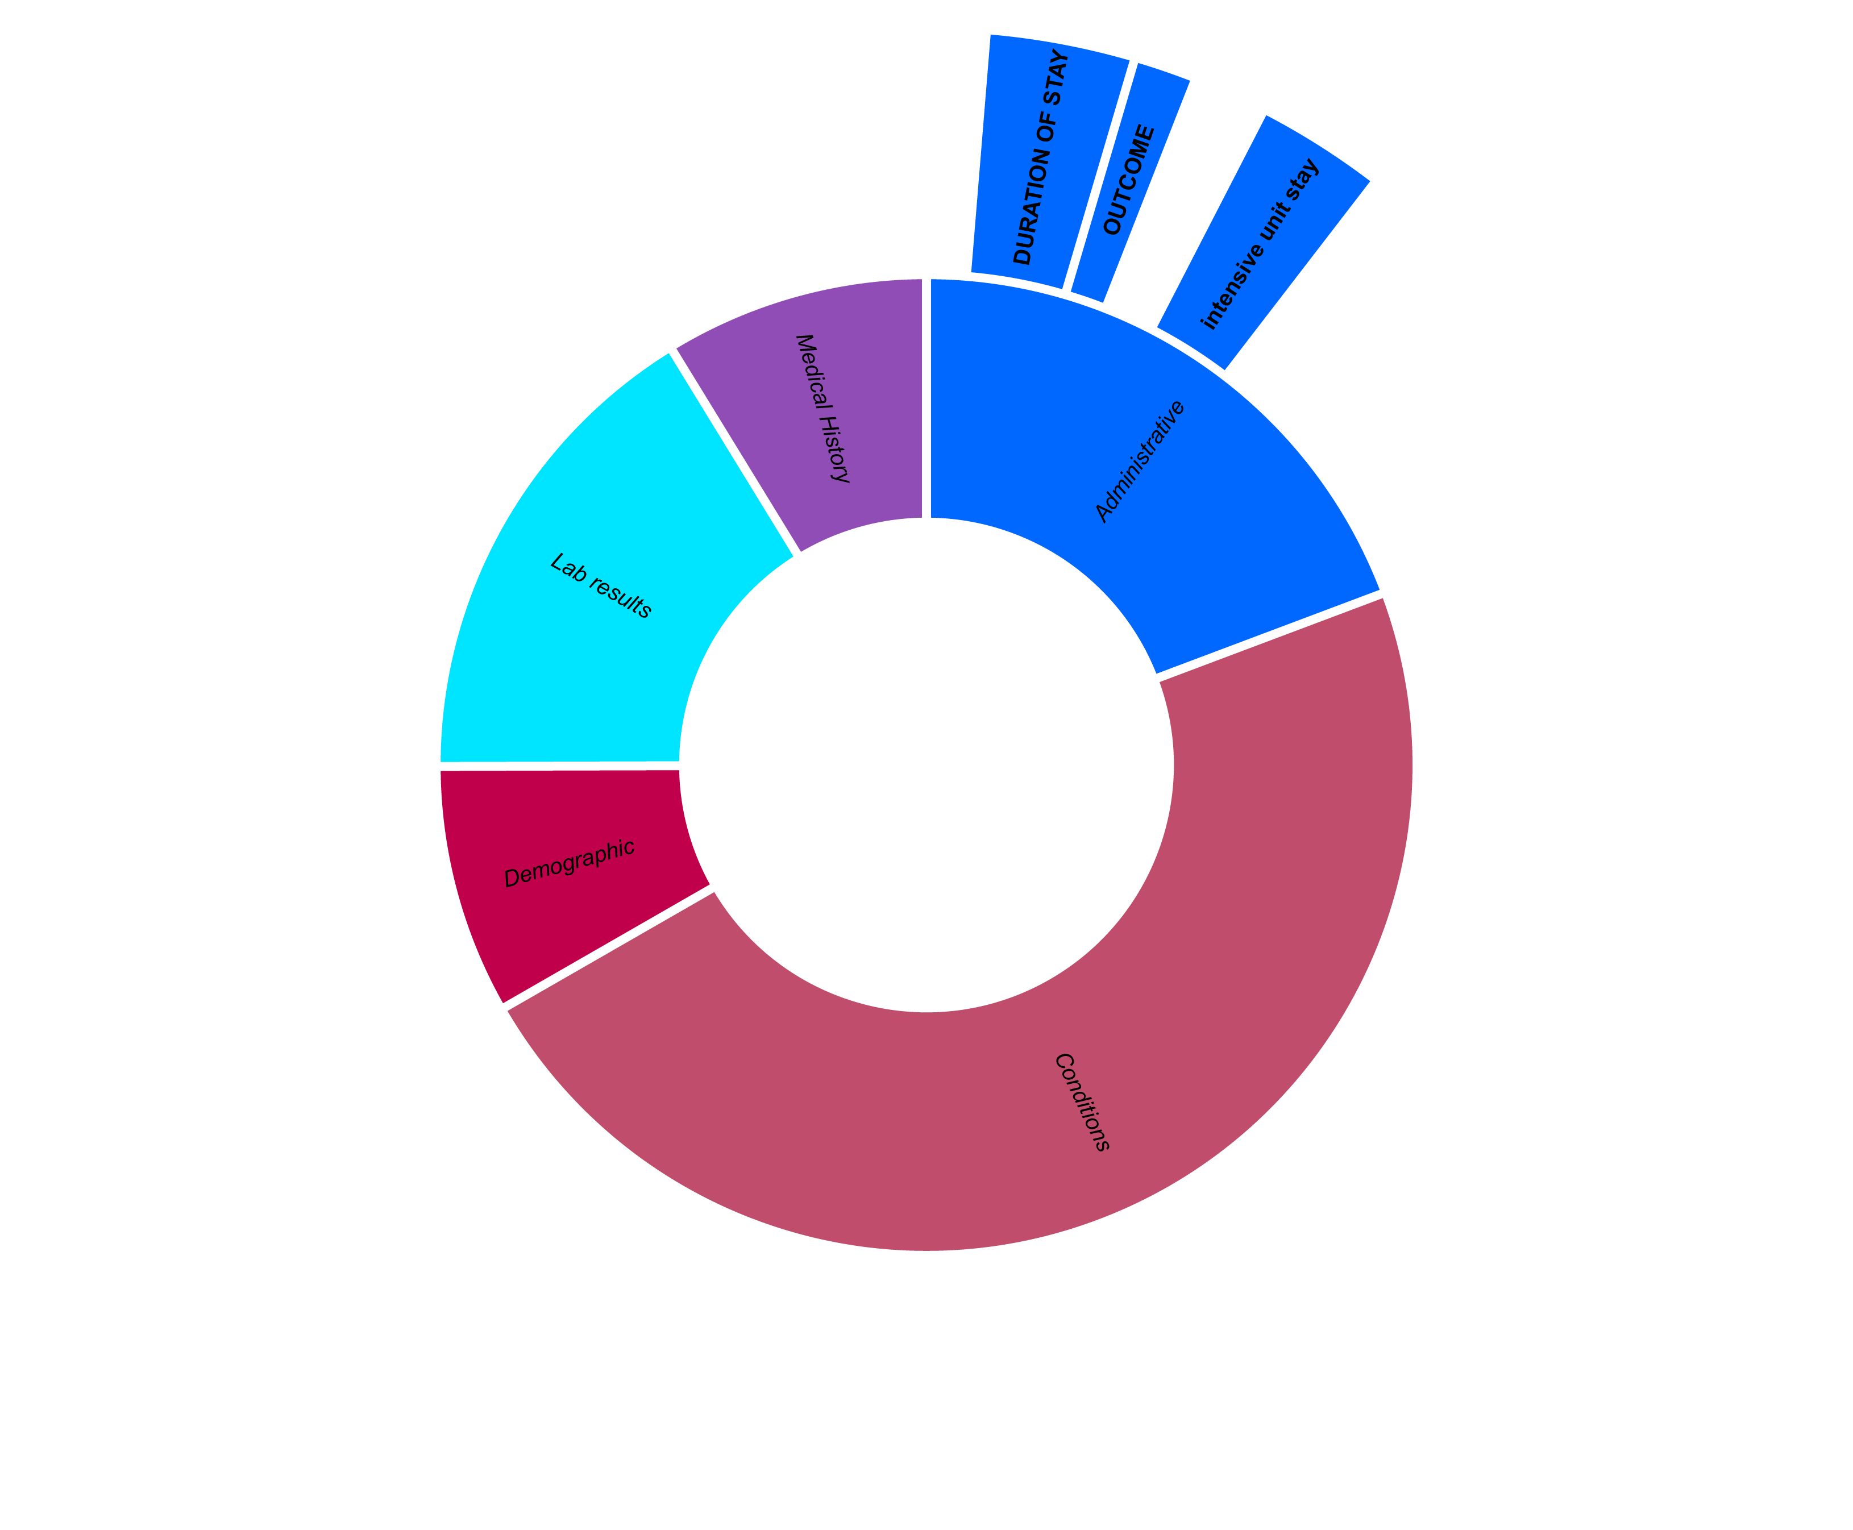
Data engineering: Adding helpful Parameters and removing Entries
Number of past visits by patient
Consider repeated visits in model without overfitting to specific patients based on their “MRD No.”
Drop invalid entries
If duration of ICU stay longer than overall stay
Notes:
LB
"Droping invalid entrys.

Slide 9
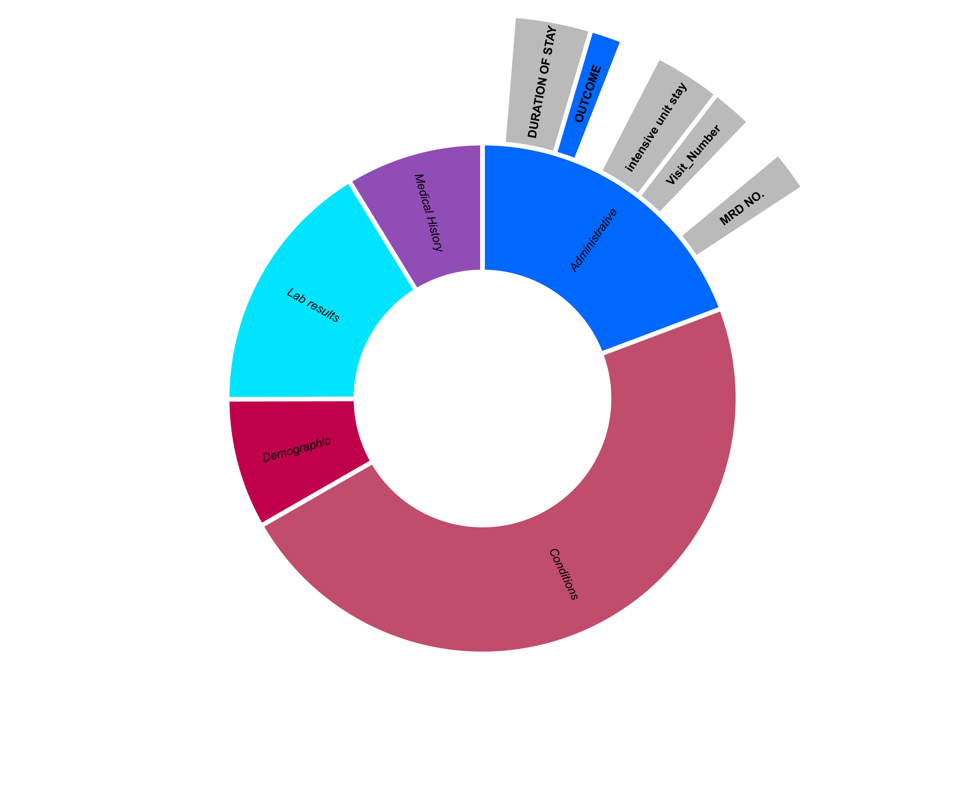
Data engineering: Adding helpful Parameters and removing Entries
Number of past visits by patient
Consider repeated visits in model without overfitting to specific patients based on their “MRD No.”
Drop invalid entries
If duration of ICU stay longer than overall stay
Remove not representative data
If patient leaves against medical advice
Notes:
LB
"Excluding cases where patients leave against medical advice from our dataset to ensure the predictability of LOS, as these outcomes introduce a high level of unpredictability."

Slide 10
Data cleaning: Remove Outliers and Parameters
Remove outliers of target variable
Standard Deviation above 3
Notes:
TW
Removing outliers of target variable

Slide 11
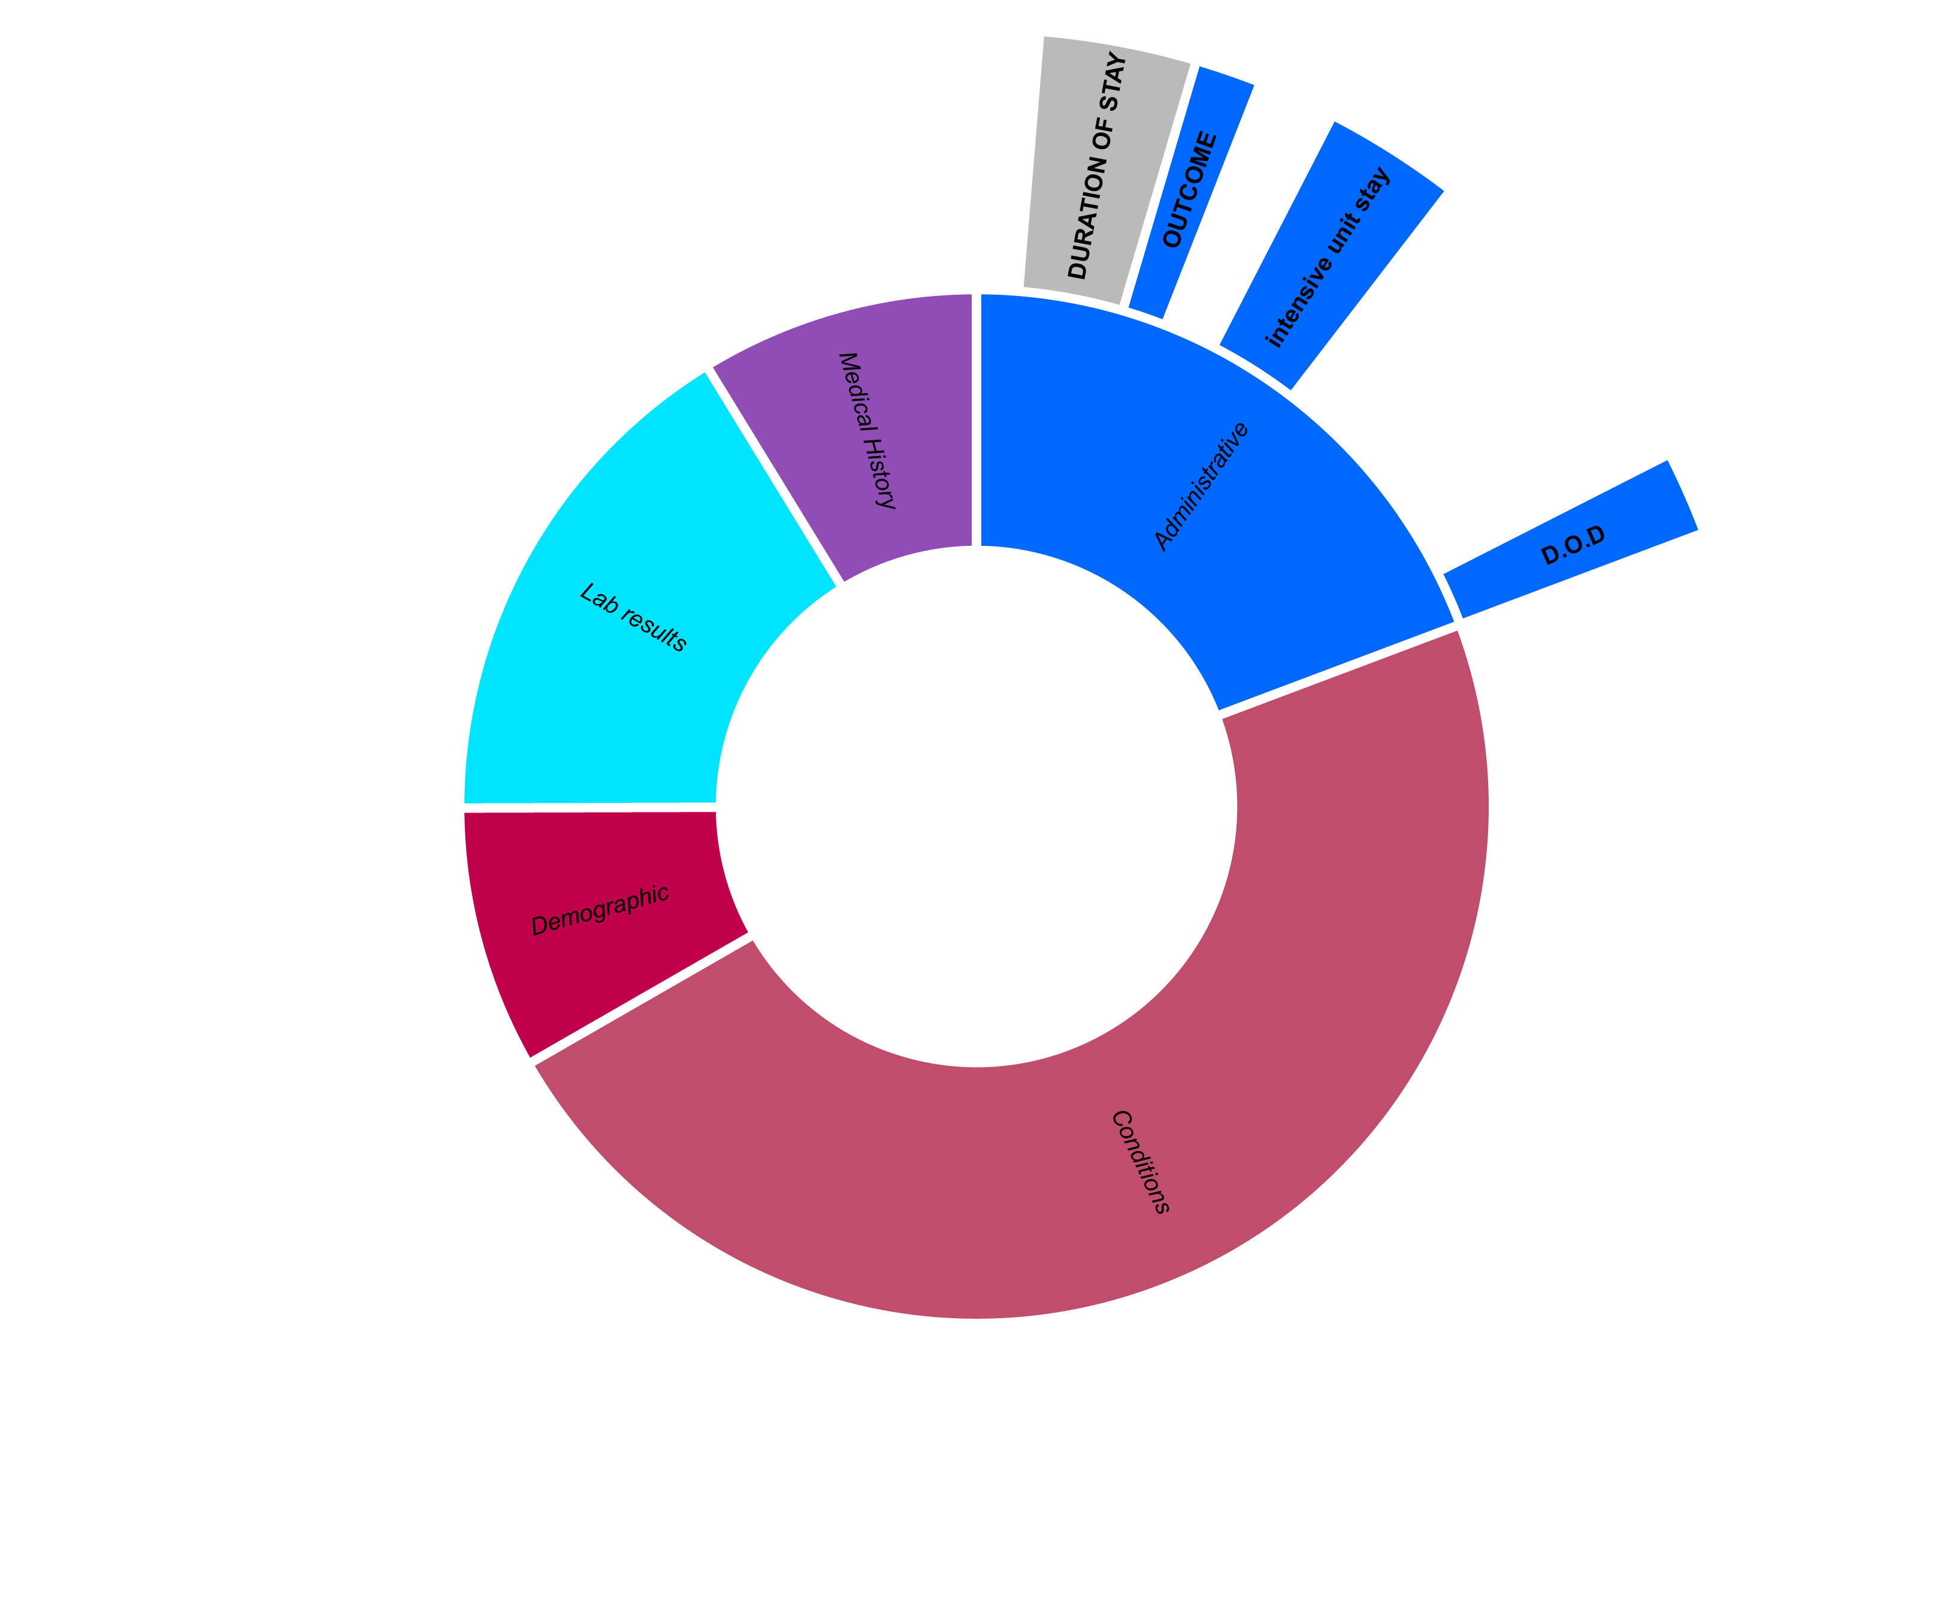
Data cleaning: Remove Outliers and Parameters
Remove outliers of Target variable
Standard Deviation above 3
Values unknown during patient stay
Notes:
TW
Remove datapoints which are only known after discharge (date of discharge & outcome)

Slide 12
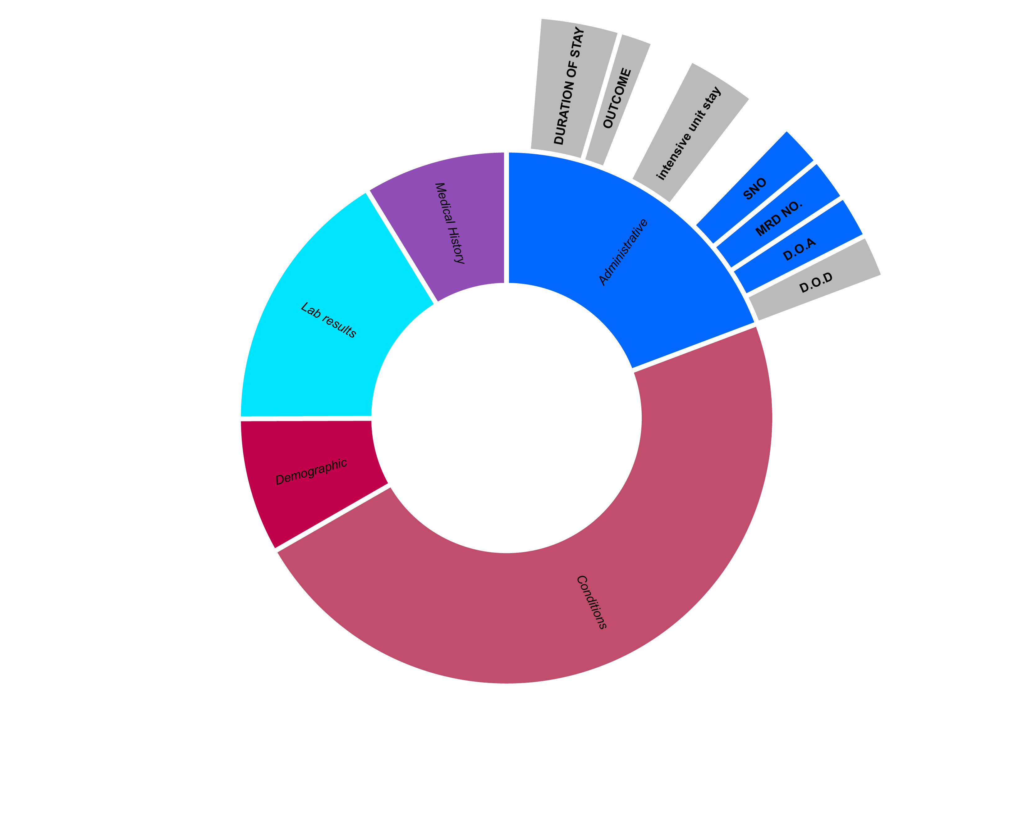
Data cleaning: Remove Outliers and Parameters
Remove outliers of Target variable
Standard Deviation above 3
Values unknown during patient stay
Redundant data points
Notes:
TW
remove parameters which already covered by other datapoints

Slide 13
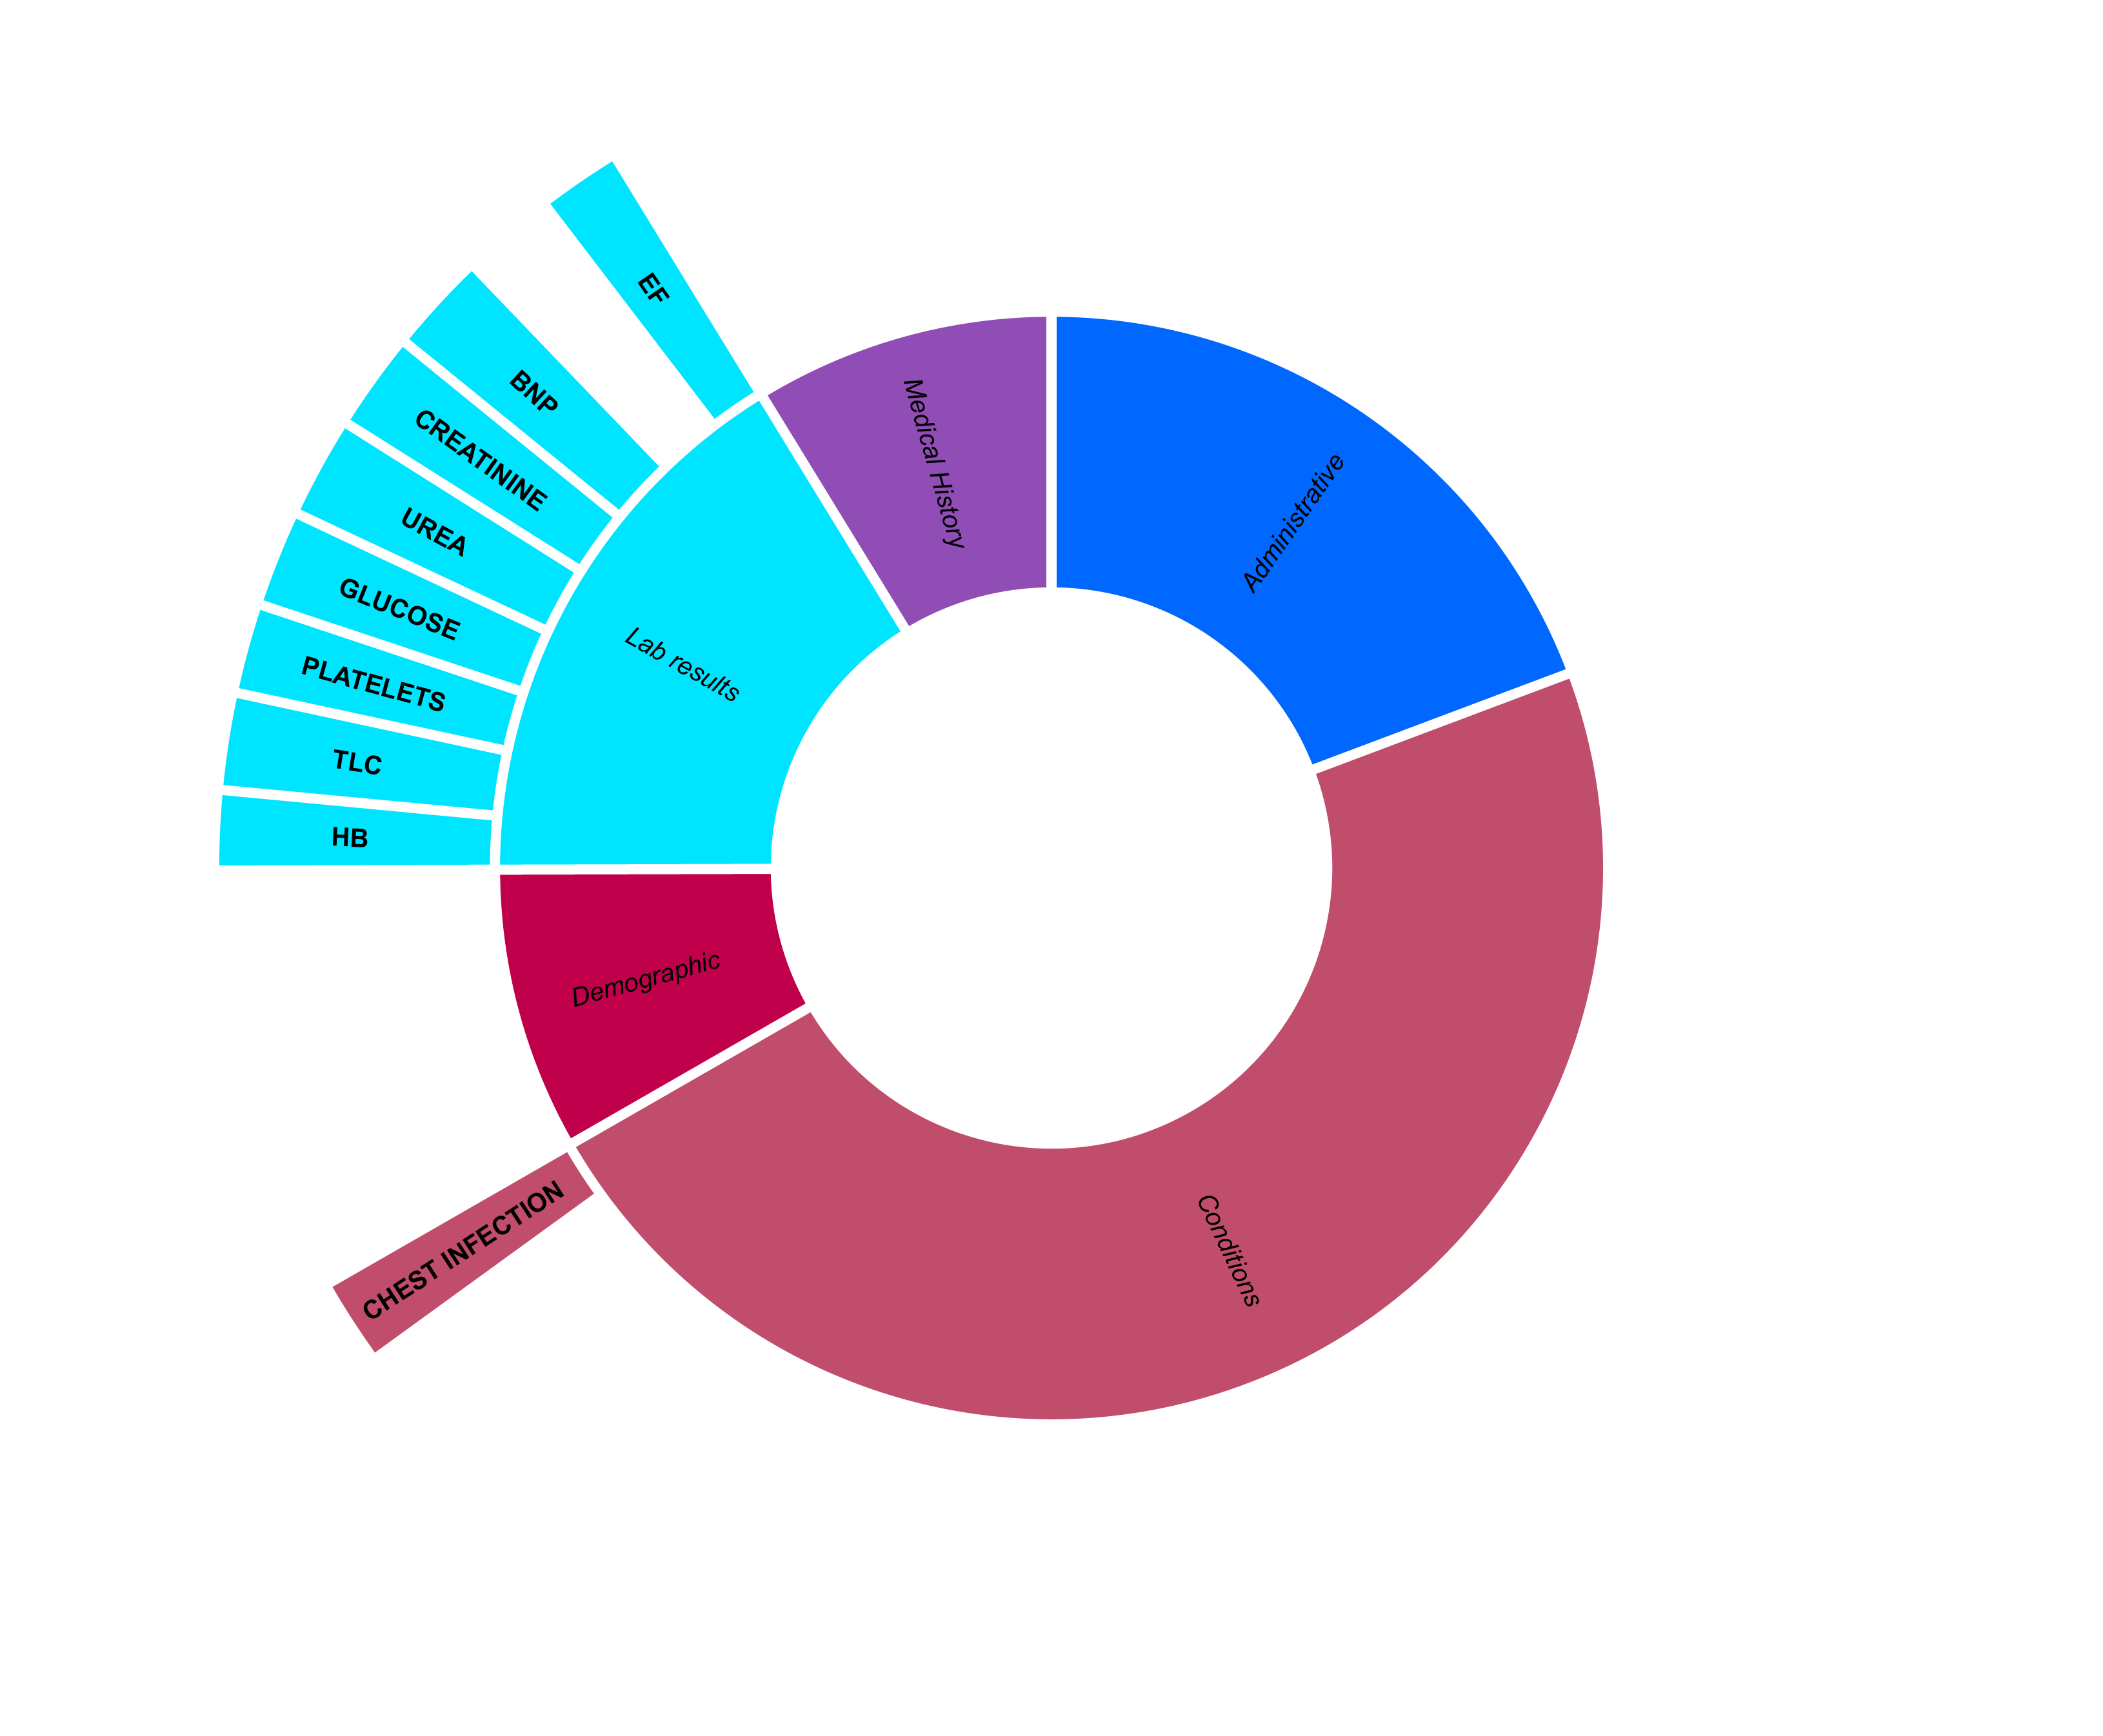
Data cleaning: Replacing Values and adjusting Datatypes
Replace empty and '' in numerical fields with 0
Keep categorical diagnoses unchanged as negative (0) differs from undetermined (EMPTY)
Notes:
TW
Addressed data integrity by setting blank entries to zero, This not done for medical conditions where ‘confirmed negative' is different to 'no data’, instead those entries were dropped.

Slide 14
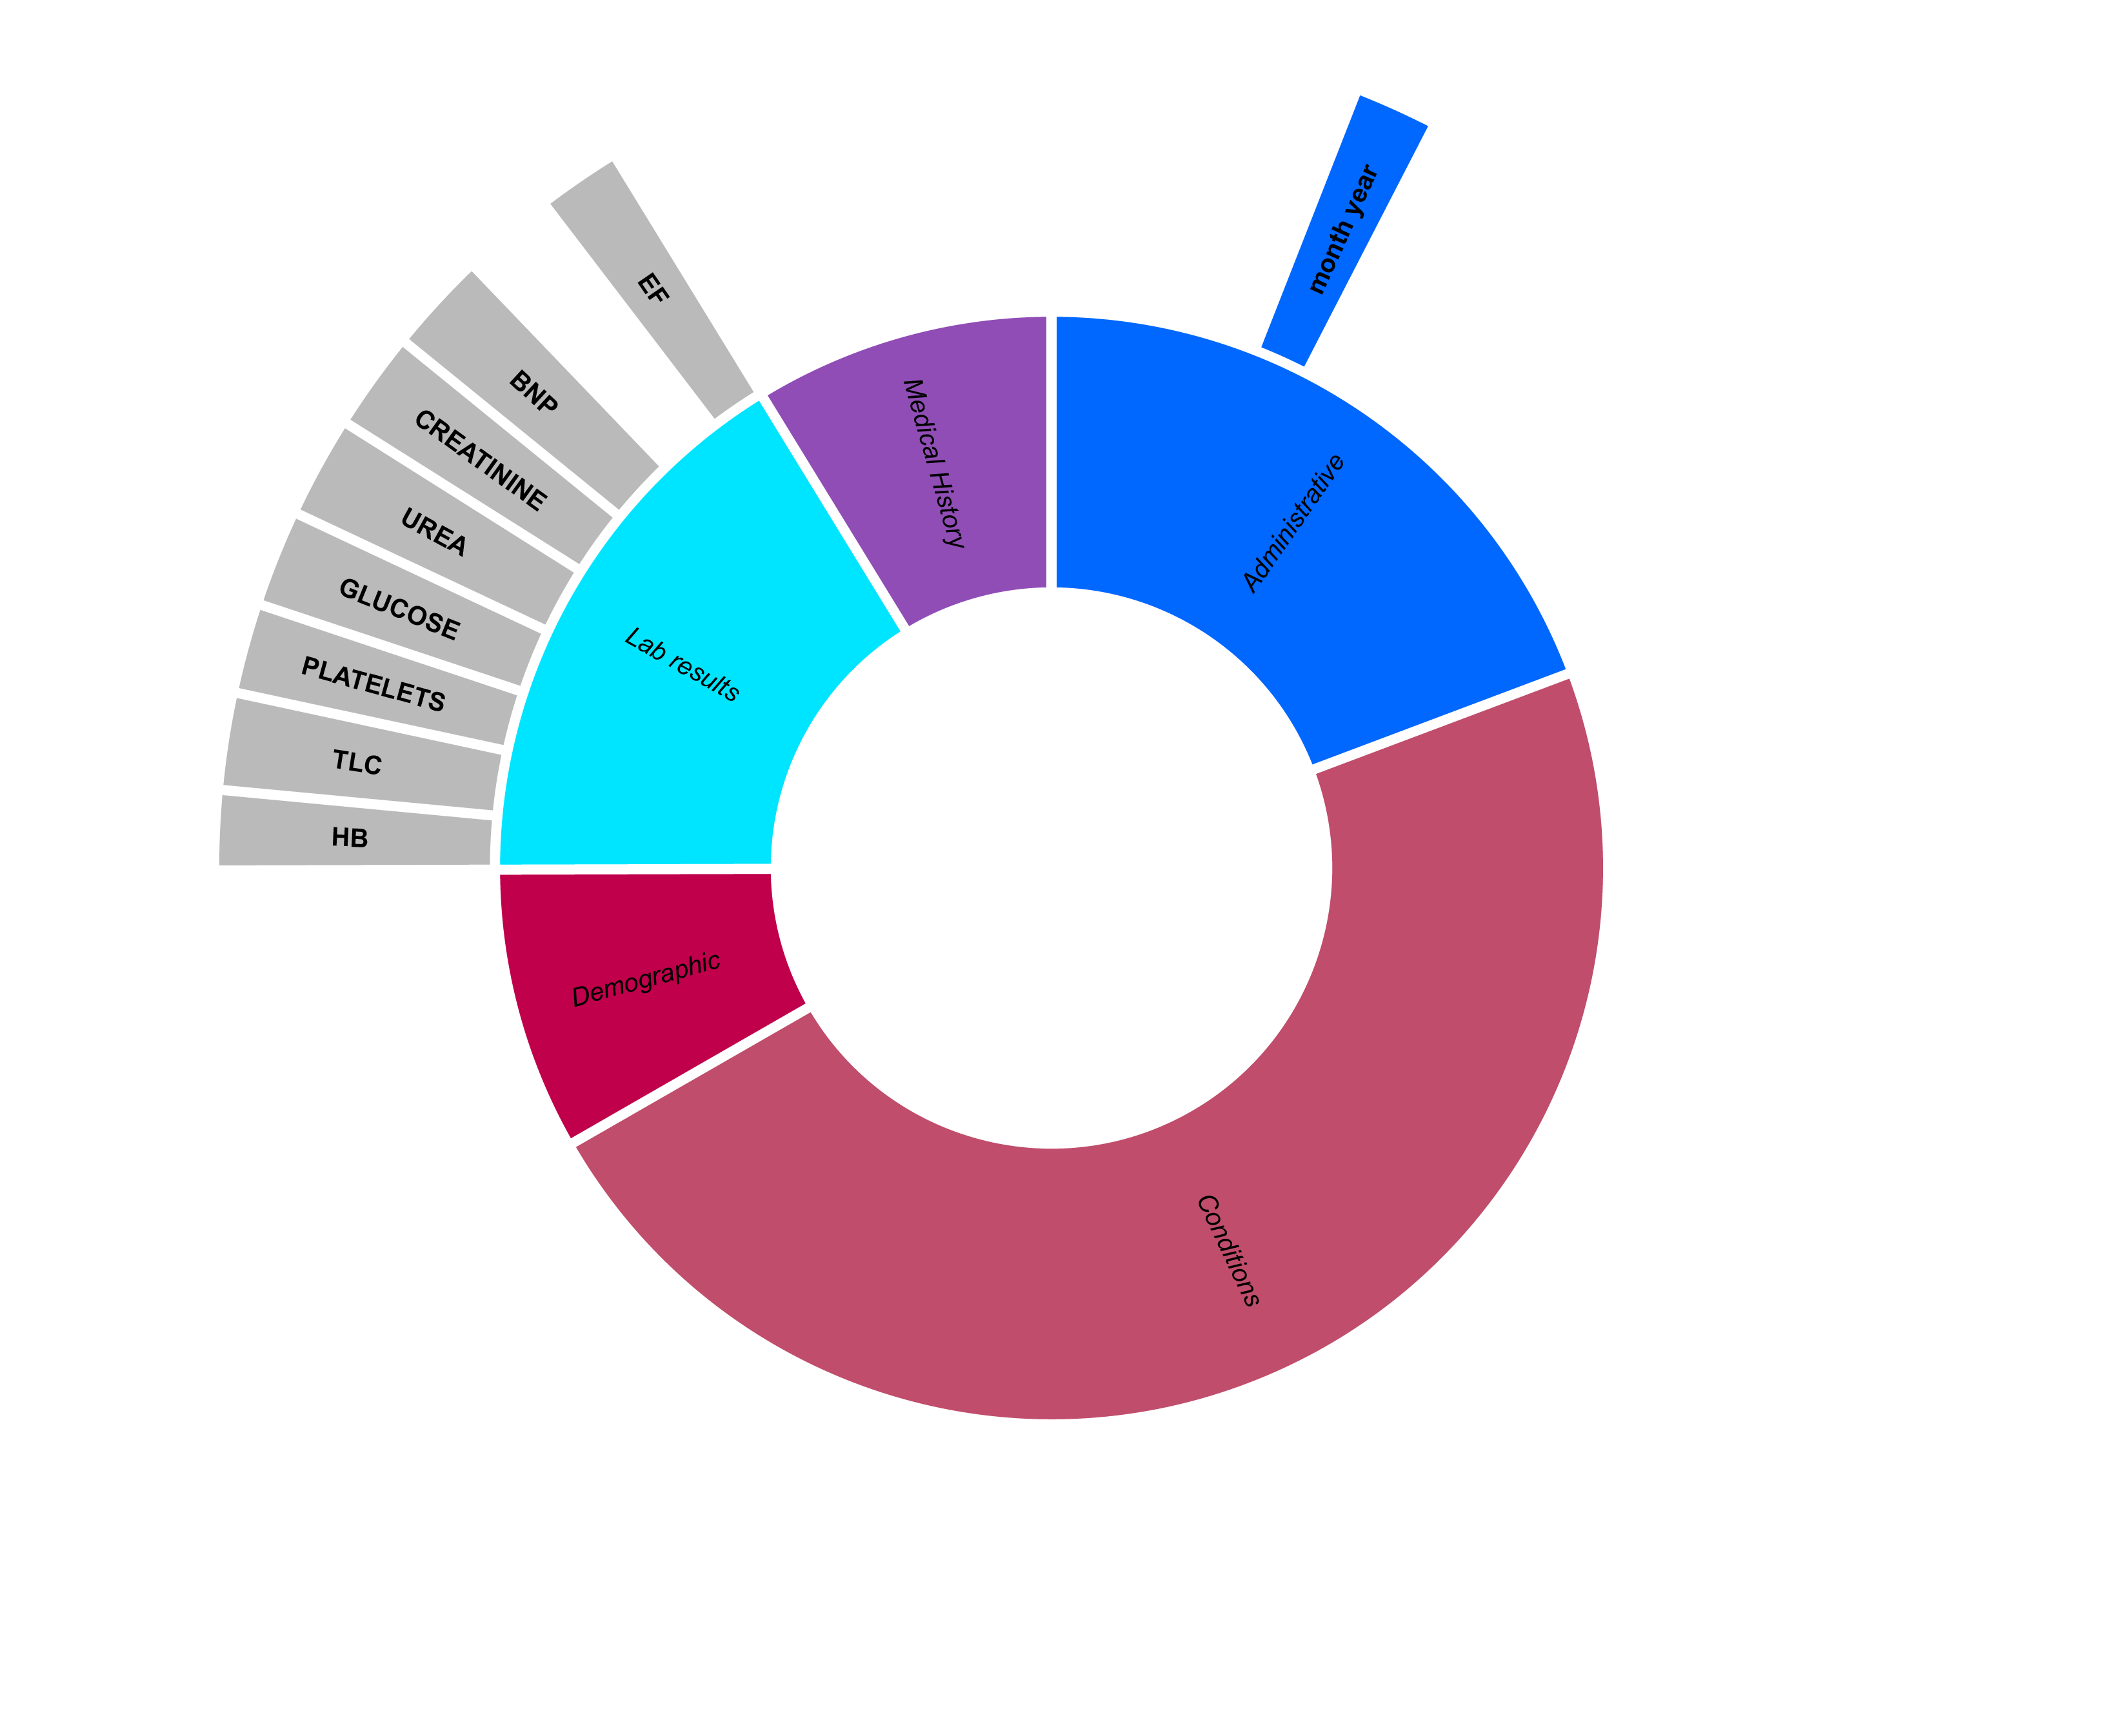
Data cleaning: Replacing Values and adjusting Datatypes
Replace empty and '' in numerical fields with 0
Keep categorical diagnoses unchanged as negative (0) differs from undetermined (EMPTY)
Converting “month year” to time datatype
Afterwards One-Hot-Encoding for models
Notes:
TW
We simplified the date information to just the month, for data generalization. And using one-hot-encoding for classification models.

Slide 15
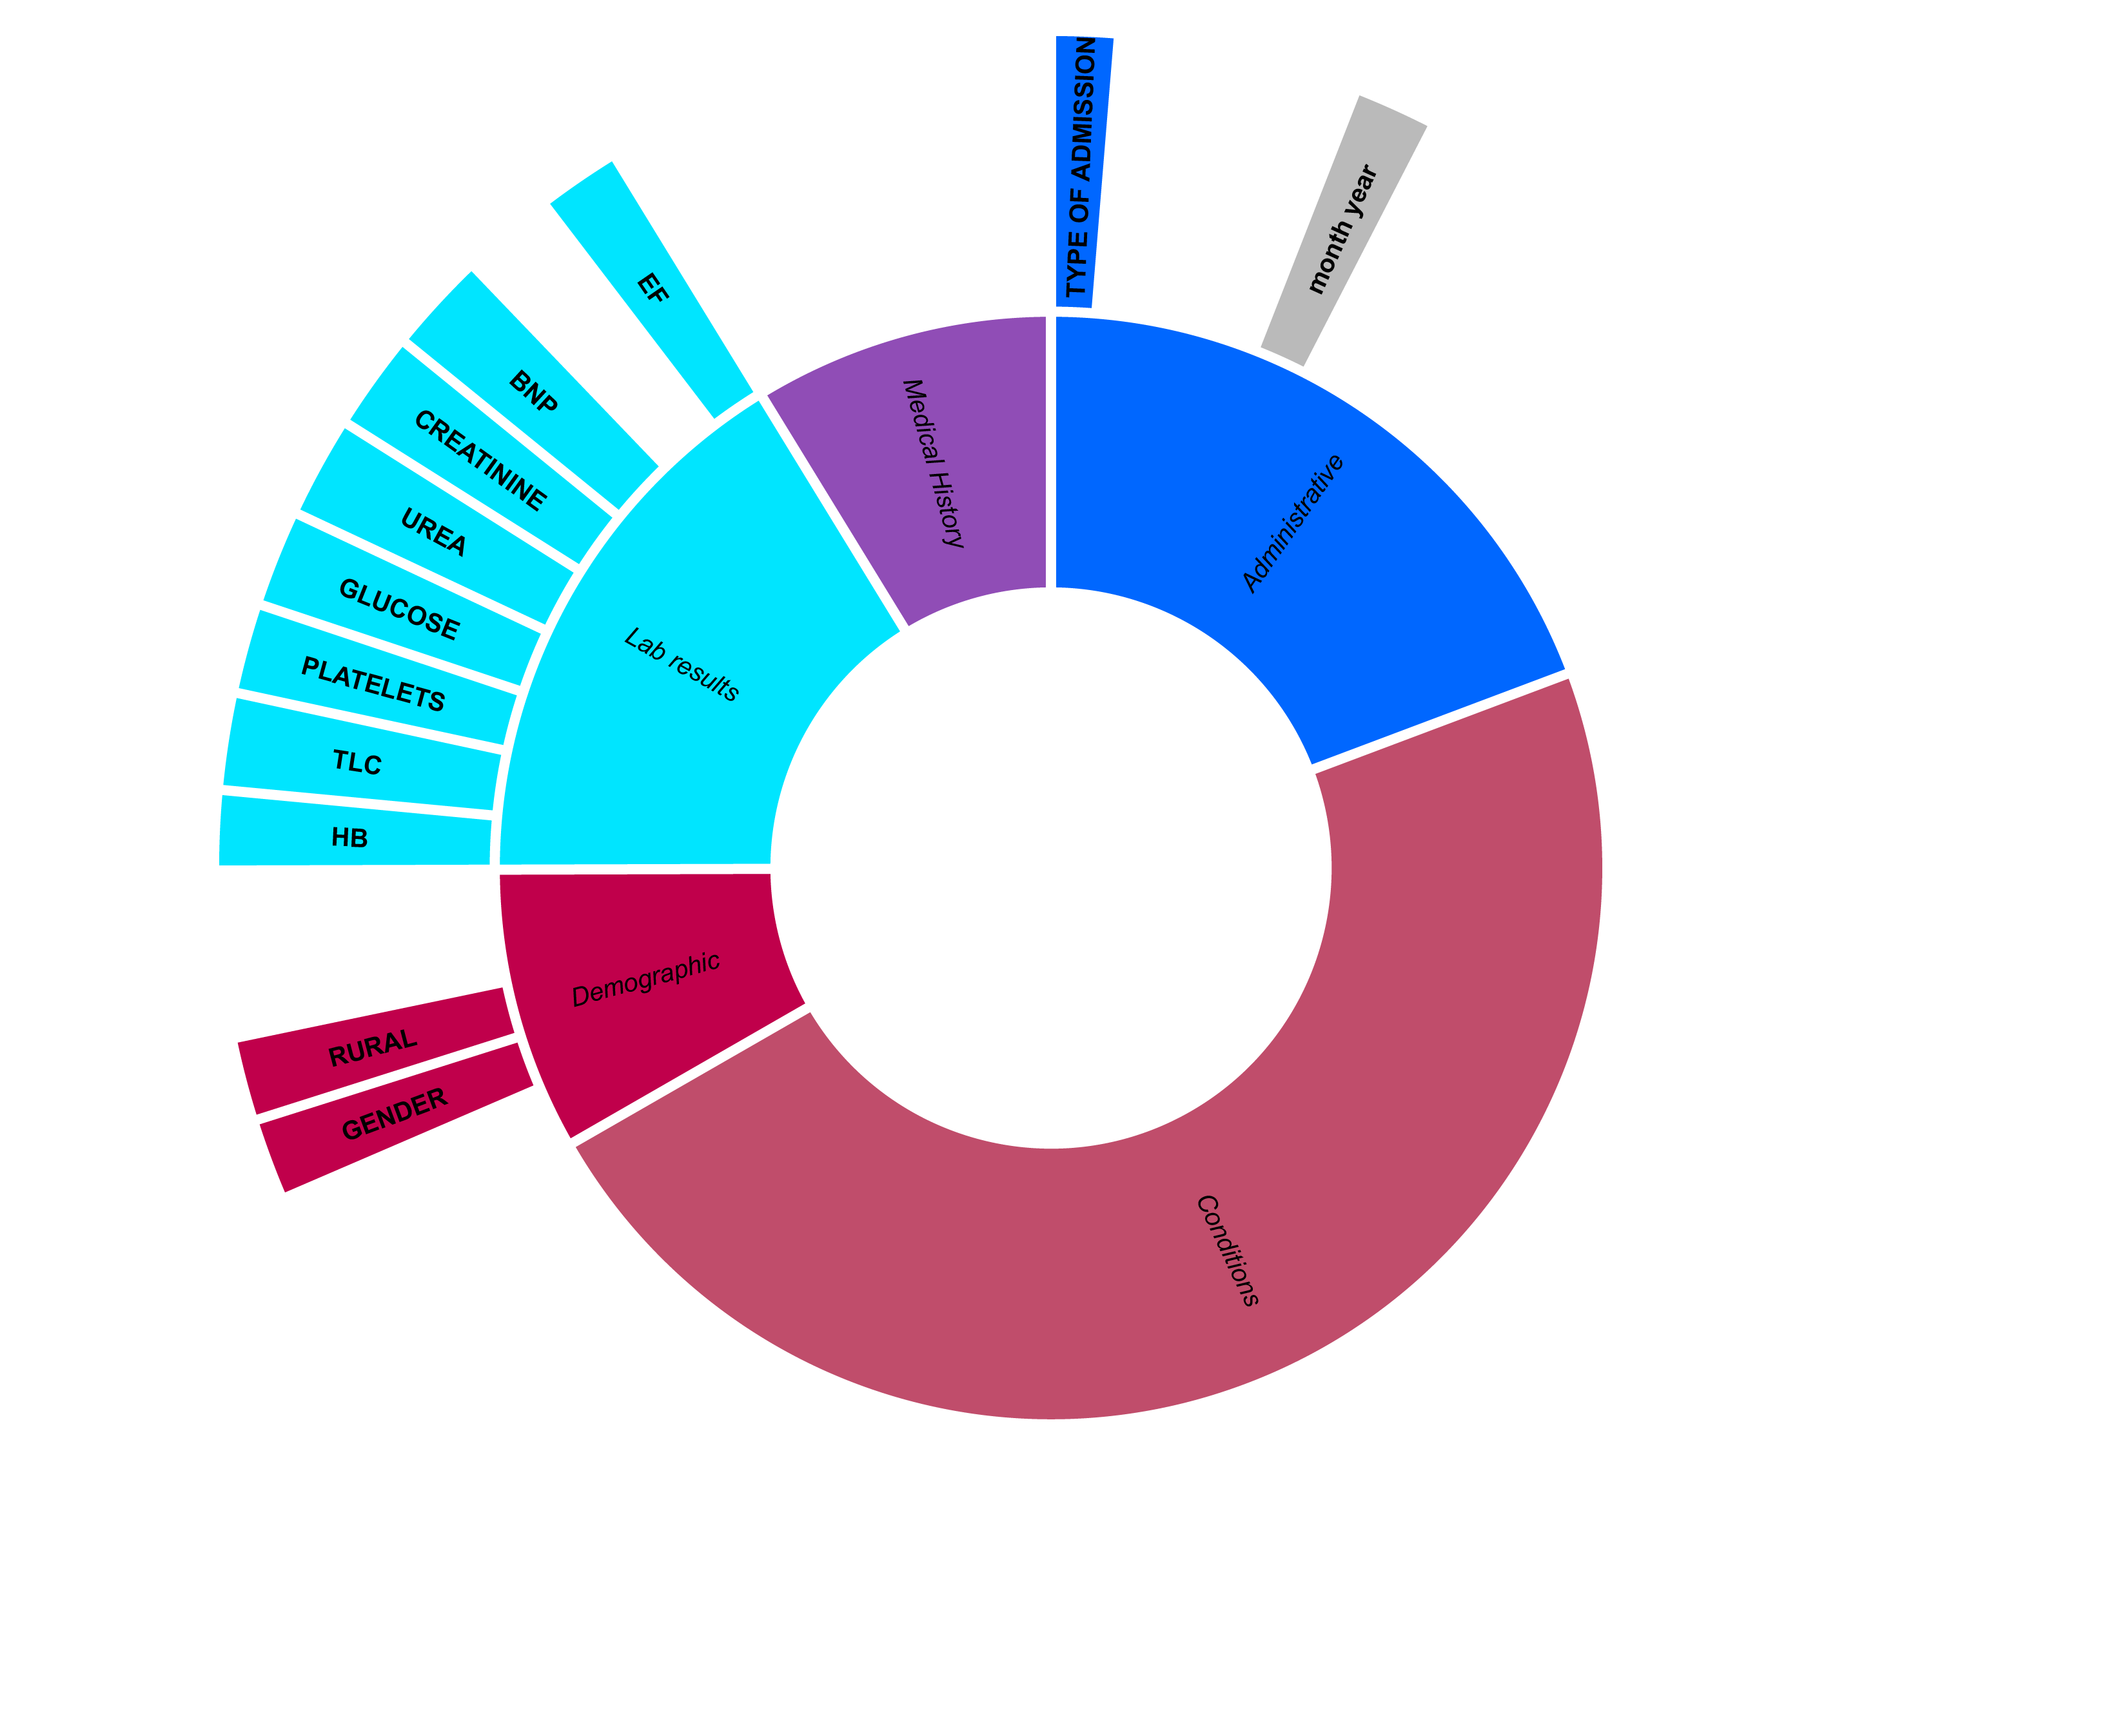
Data cleaning: Replacing Values and adjusting Datatypes
Replace empty and '' in numerical fields with 0
Keep categorical diagnoses unchanged as negative (0) differs from undetermined (EMPTY)
Converting month year to time datatype
Afterwards One-Hot-Encoding for models
Convert categorical types to float
Notes:
TW
For NN converting categorical datapoints into floats

Slide 16
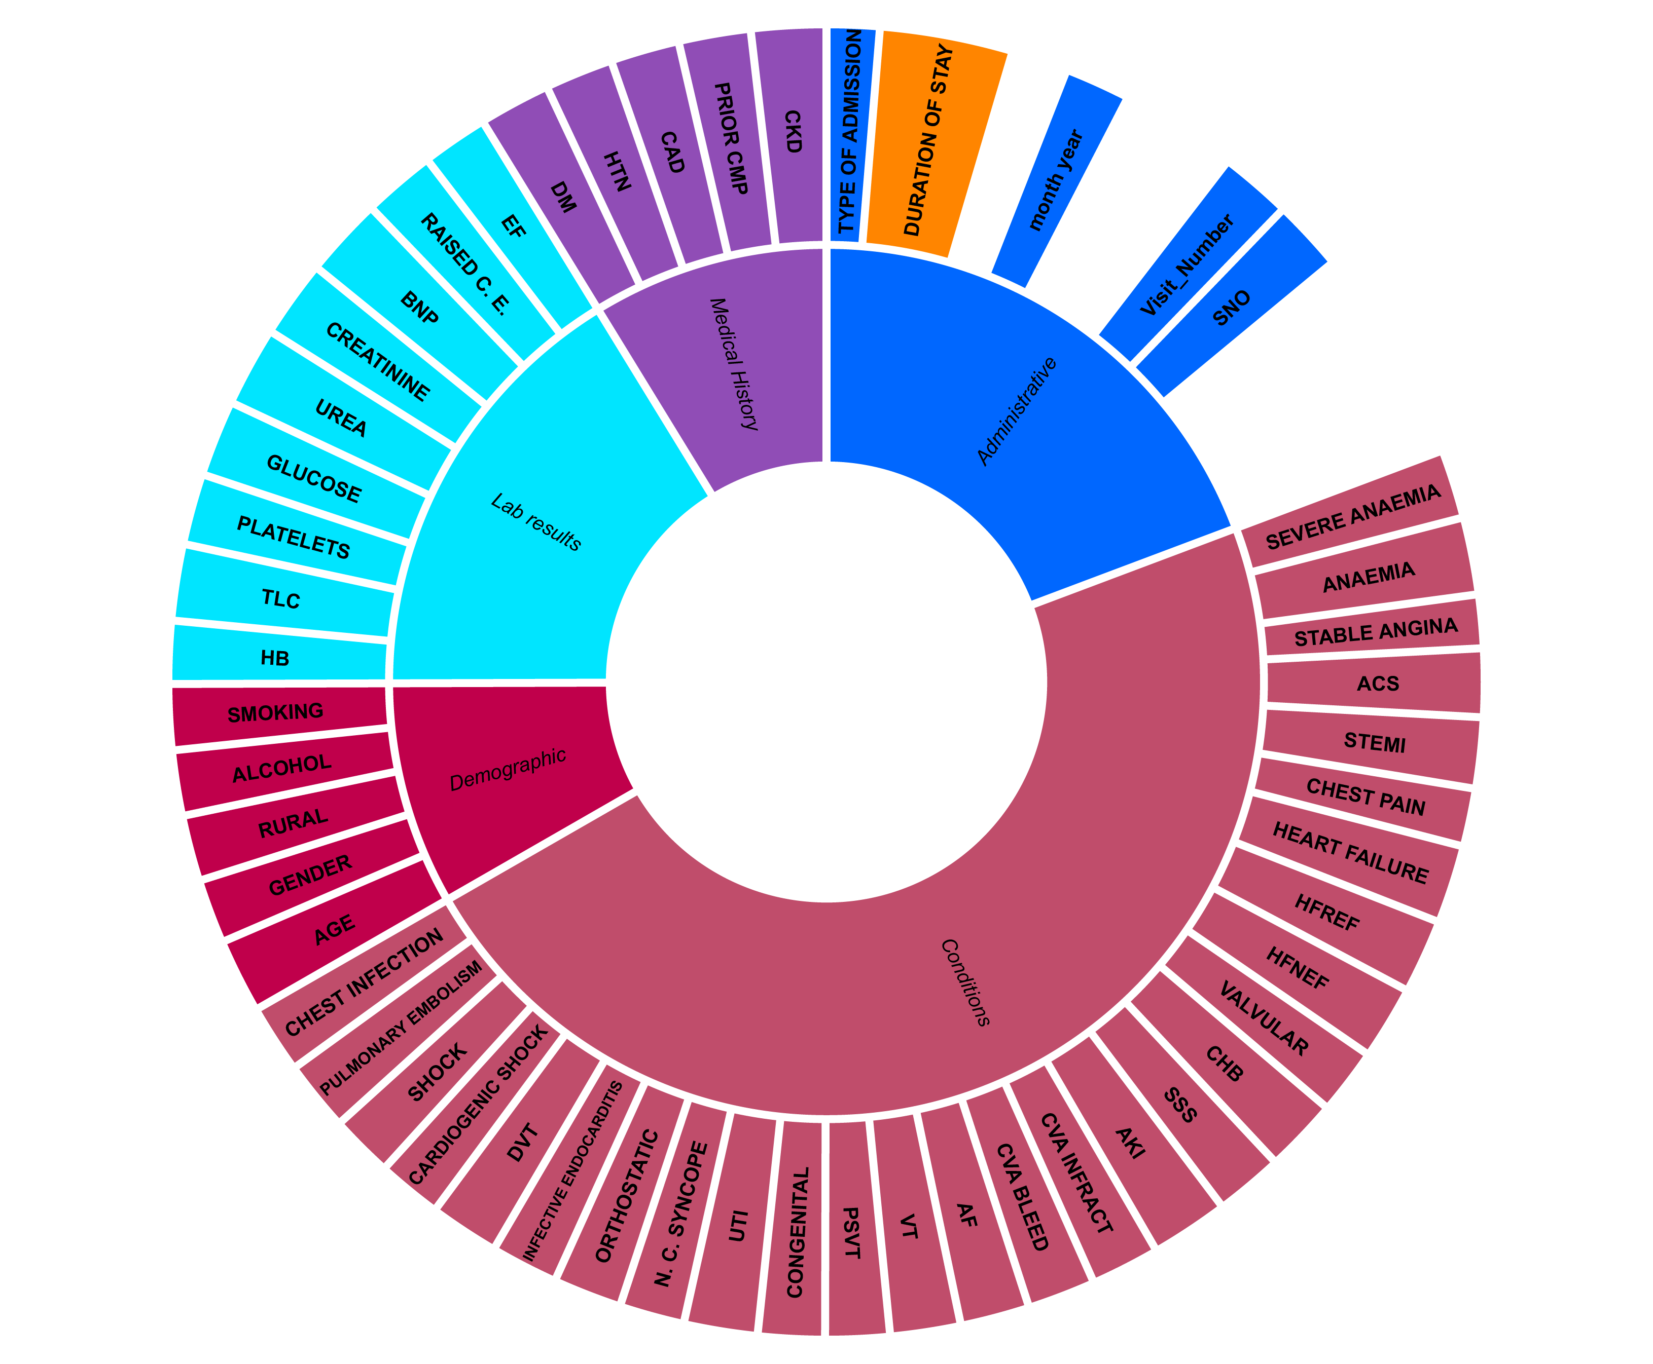
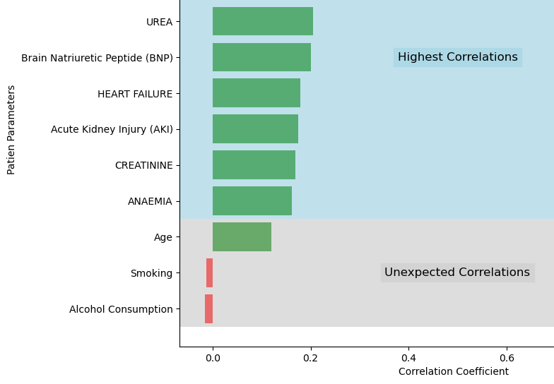
Data Insights: Overall low correlations
Target variable: Duration of Stay
No clear indicators of length of stay
Notes:
TW
Overview of cleaned data.
Width of bars represent correlation to duration of stay (our target variable). Most correlations are low with highest being 0.2

Slide 17
Data Splitting
with sklearn Library train_test_split
15’409 Rows
Train
(70%)
Validate (10%)
Test
(20%)
Scaling
Sklearn StandardScaler
Sklearn MinMaxScaler
More precises because few outliers
Stratifying
Length of stay (either value or class)
Highest parameters in FeatureSelect (only Random Forest)
Negligible impact
Notes:
SG-Tired both approaches MinMaxScaler was better since few outliers in medical/patient information.
Train/Validate/Test split of 70/10/20.
Tried different types of scalers, and went with sklearn MinMaxScaler as most accurate with few outliers
Stratified to ensure equal split of target variable, to sensure equal split.
Stratifying other variables with suspected impact (e.g. type of admission) didn't have an impact for the Random Forest)

Slide 18
Study 1 - Decision Tree Model (Regression)
Moving towards Classification
Methods:
Library sklearn DecisionTreeRegressor
Optimisation: Hyperparameter tuning (Library GridSearchCV)
Results:
Accuracy with 1 day tolerance: 43%
Overfitting issues due to many features and low correlations.
Takeaway:
Highly interpretable but limited in handling complex patterns.
Getting a precise numerical prediction will be difficult. Ranges could be more helpful.
Class 1
(1-3d)
Class 2
(4-6d)
Class 3
(7-14d)
Class 4
(15d+)
Possible added value for Hospitals
Medical personnel can also see how Probabilities split between classes
Notes:
TW
Started with a regression model using sklearn's Decision Tree Regressor.
Reached 43% accuracy post hyperparameter tuning.
Shifted to classification for clearer predictions, defining four stay length categories.
This change aids healthcare workers in estimating patient stay durations more effectively.

Slide 19
Study 2 – Random Forest (Classification) Need for further accuracy improvement
Methods:
Library sklearn RandomForestClassifier, Accuracy Score
Categorized Length of Stay (LOS) into predefined groups.
Results:
Accuracy: 70%.
Better generalization in categorizing LOS.
Takeaway:
Improved performance and relevance in clinical decision-making.
Notes:
LB
LB "We switched to Random Forest classifiers due to their effectiveness with datasets having low feature correlation. Alongside with our switch to classification, this leading to a noticeable improvement in accuracy up to 70%. Despite this progress, the accuracy still isn't sufficient for real-world applications."

Slide 20
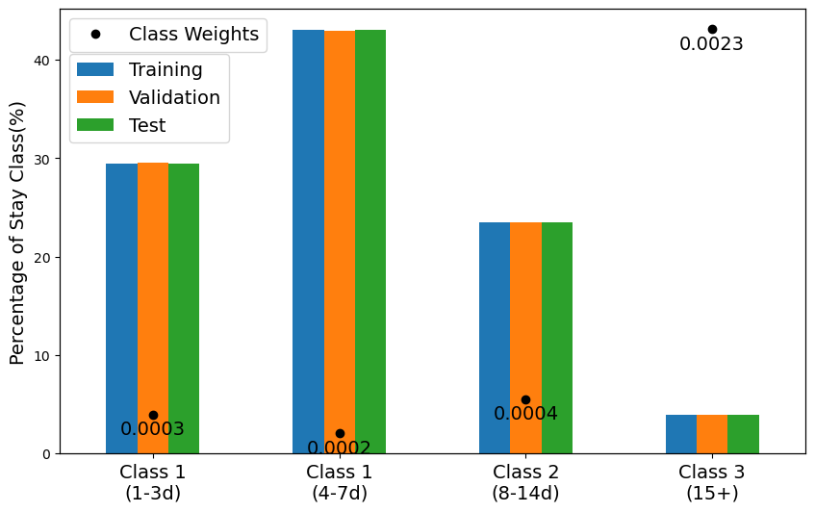
Study 3 - Neural Network Chosen Model
Designed to capture complex data patterns.
Methods:
Neural Network with 5 layers.
Categorized LOS into predefined classes.
Weights to balance out imbalanced dataset
Results:
Accuracy: 93%.
Superior in modelling intricate relationships.
Takeaway:
High accuracy, complex model, computationally intensive, less interpretable.
1 (1-3d) 2 (4-6d) 3 (7-14d) 4 (15d+)
Notes:
SG - Two times class 1
Using classes as mentioned earlier, created weights to balance out imbalanced dataset (see chart with distribution & weights)
results & takaway

Slide 21
Neural Network: Architecture 3 hidden Layers with ReLU Activation and Batch normalisation
49
256
128
64
4
ReLU
Batchnorm
ReLU
Batchnorm
ReLU
Batchnorm
Notes:
SG
5 Layers, 3 of which are hidden. Each with ReLU Activation & Batch normalization
49 neurons->256 neurons

Slide 22
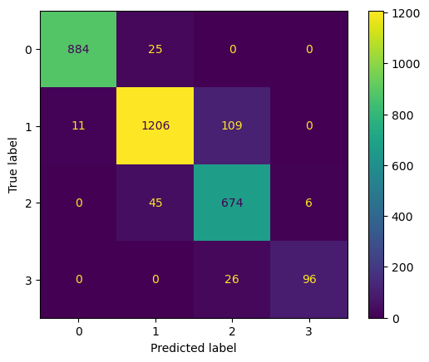
Neural Network Results 92.8% Accuracy
Results
Prediction of length of stay for all patient (non-ICU)
Classification Problem (4 Classes)
300 epochs, lr=0.00007
Confusion Matrix
92.8%
 | 0 | 1 | 2 | 3
F1-Score | 0.98 | 0.93 | 0.88 | 0.86
 | Macro avg. | Weighted avg.
F1-Score | 0.91 | 0.93
Notes:
SG
Accuracy of 92.8%.
- with f1 score can see the longer the predicted stay, the less accurate model gets, influence by our unbalanced dataset even with weights.
- with confusion matrix can see most often error between class 1 & 2.
- Noteworthy that no large mispredictions, always only error by 1

Slide 23
Neural Network: Confusion Matrix No major mislabeling of model

Slide 24
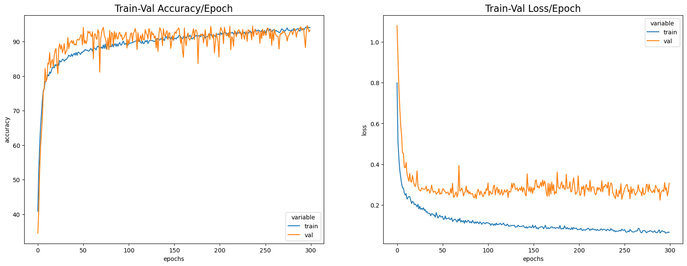
Neural Network: Results
Notes:
SG

Slide 25
Our conclusion:
GOOD ON PAPER,
DIFFICULT IN APPLICATION
STATIC ENVIRONMENT
SIMPLE DATA FLOW
NO CONSEQUENCES
HARD INTEGRATION
ASCENDING PREDICTIONS
BIG FEATURE VARIABILTY
Notes:
TW
Reflecting back on our approach, we tried different models to refine our accuracy. The final Neural Network model performs well when we have all patient data upfront in a simulated setting.
LB
Transitioning to a hospital setting, however, presents us with practical challenges. Integration into healthcare systems is complex, with rigorous regulatory standards and ethical concerns. The model’s real-world effectiveness hinges on ascending predictions and the variability of features from one hospital to another. Next time we would lay more focus on this.
In essence, while our model is effective in a controlled environment, applying it in a live healthcare setting is not as straightforward, good on paper, difficult in application.
SG
Thank you for your attention. Now, we’d like to hear your thougths and questions.

Slide 26
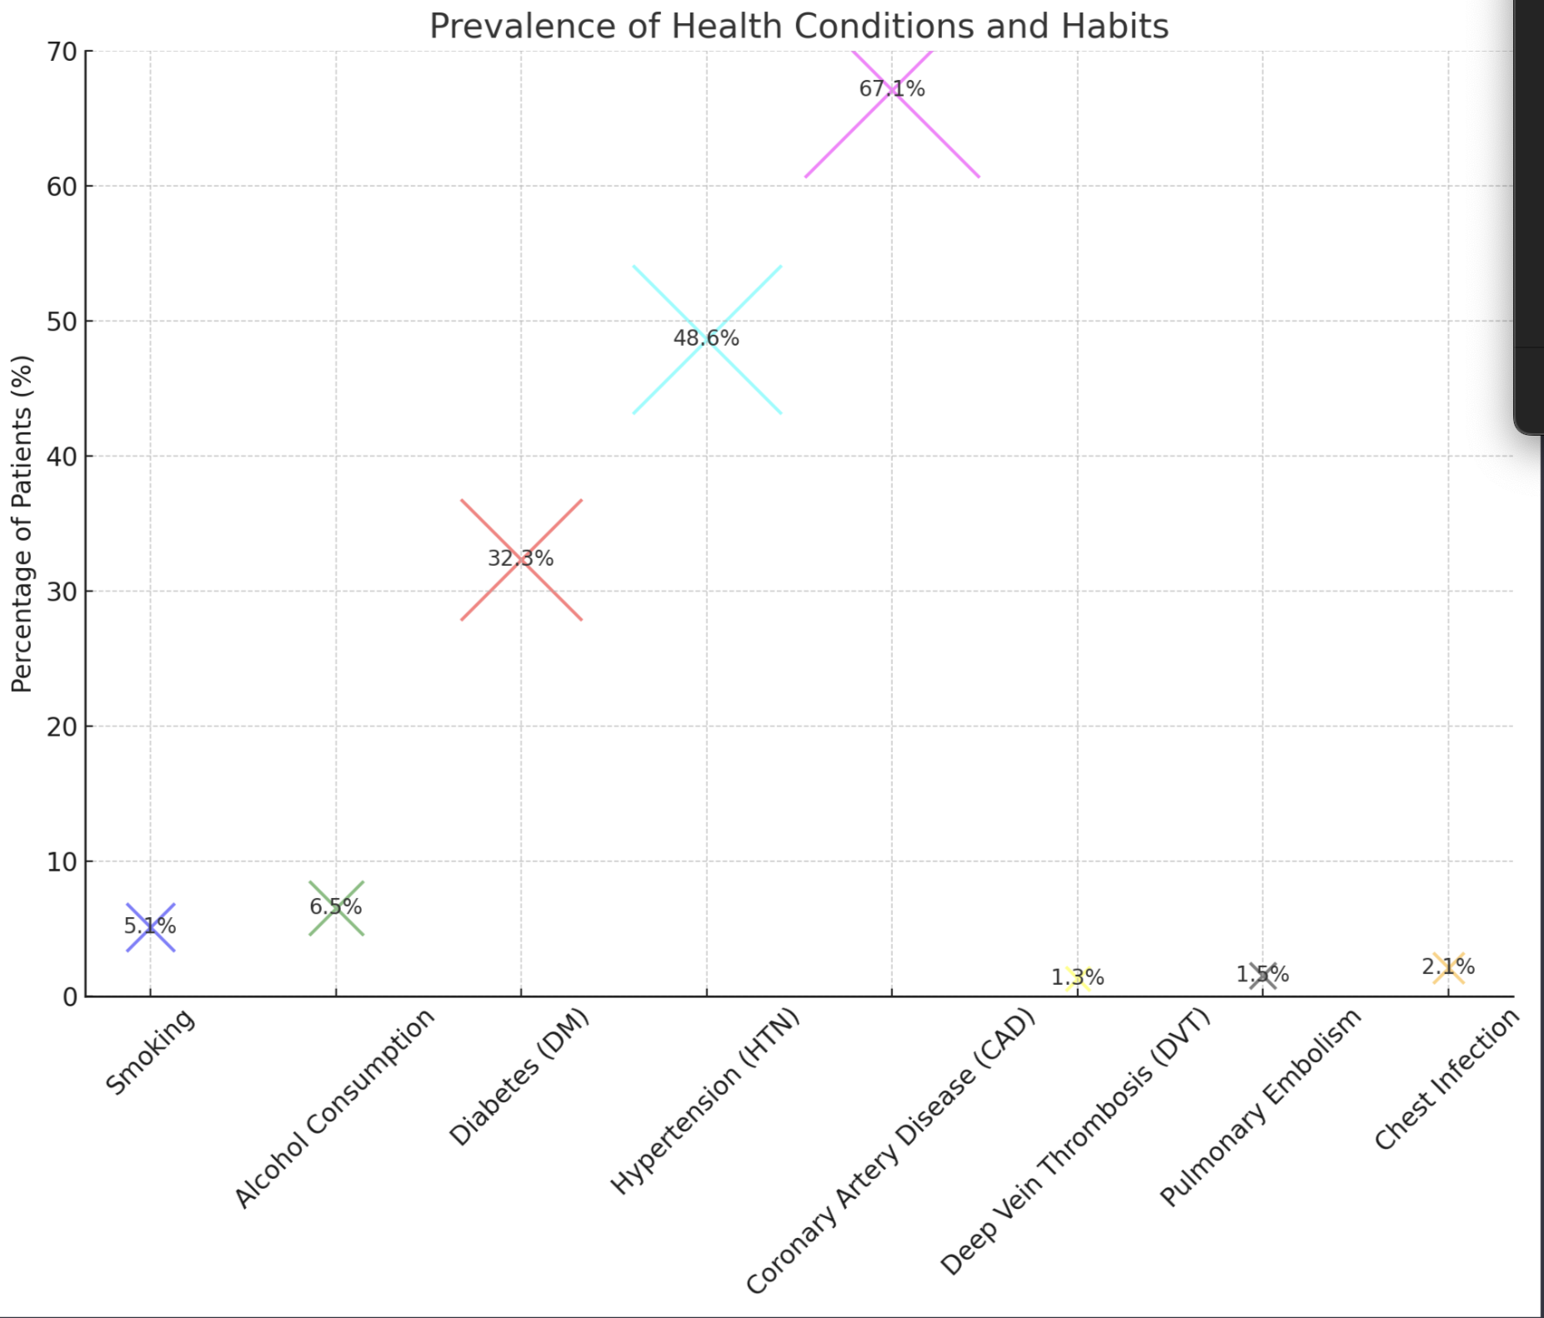
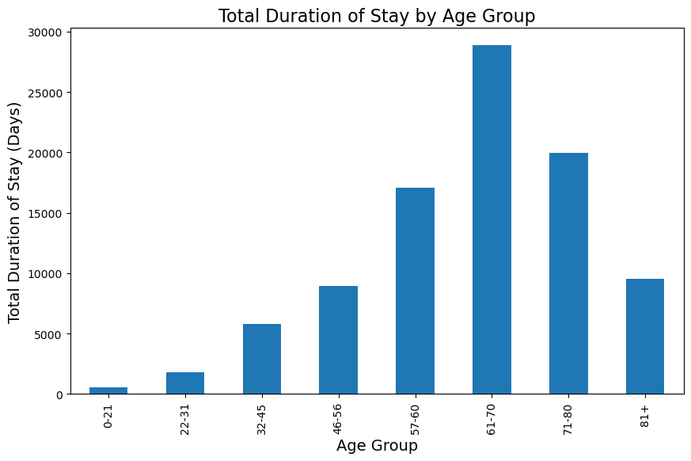
Data Insights: Age distribution and Prevalence of Medical History

Slide 27
Decision Tree Model: Parameters
regressor = DecisionTreeRegressor(
criterion='absolute_error’,
max_depth=7,
min_samples_leaf=4,
min_samples_split=10)

